Slide 1
VITA Application Wire Frames
Volunteer and Site Coordinator App v2
Client App (iOS and Android) and Web

Slide 2
Notes
Passwords expire in May each year
Up to the client device to clear the stored password in May
Users must be flagged in the admin UI to see mobile sites
Need super admin
System wide passwords for
Volunteers, site coordinators, admin, super admin
Set season first date, last date
User record needs to contain
Request for preferred site notifications, mobile site notifications
List of preferred sites (not for clients)

Slide 3
Notifications Generated
On site details changed
To any user with that site as a preferred site (client or vol)
If site is a mobile site, then to any user with mobile flag
Details: address, city, state, zip, calendar (not sc’s)
Manually

Slide 4
Emails to admins generated
On new suggestion

Slide 5
Stored on local device (or in a cookie)
User email/password if provided (encrypted)
List of preferred sites
Last filter used

Slide 6
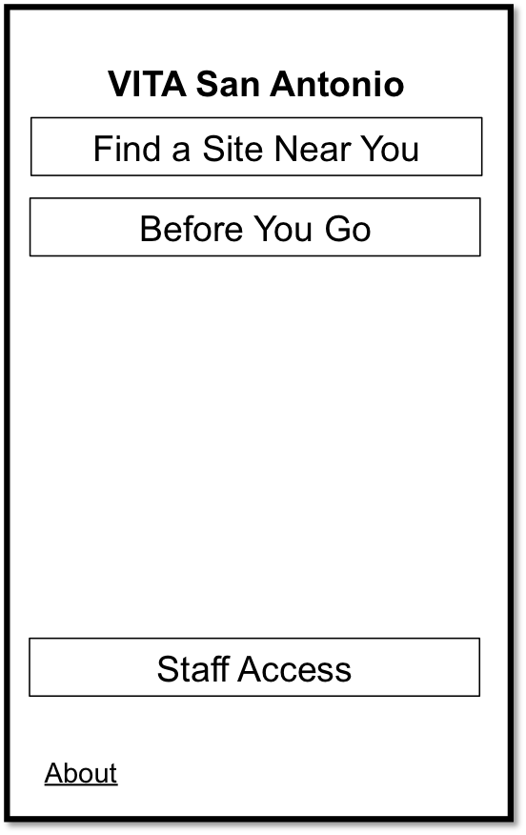
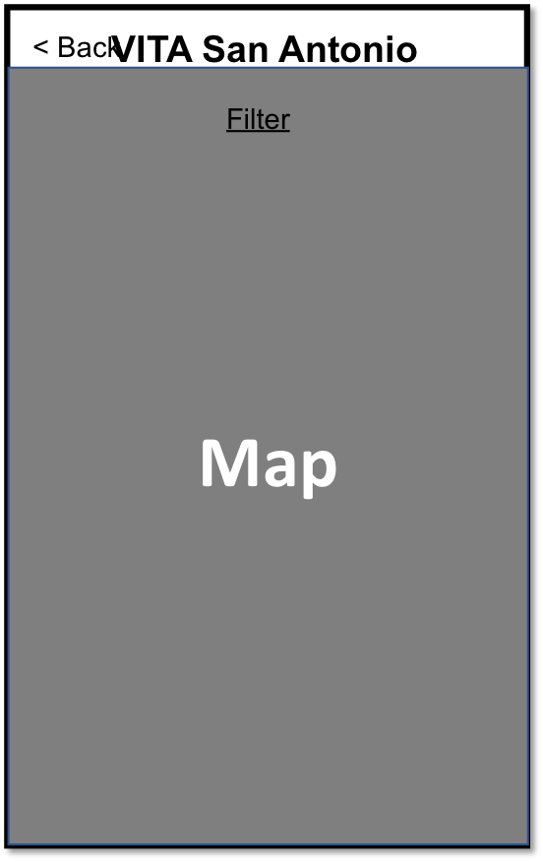
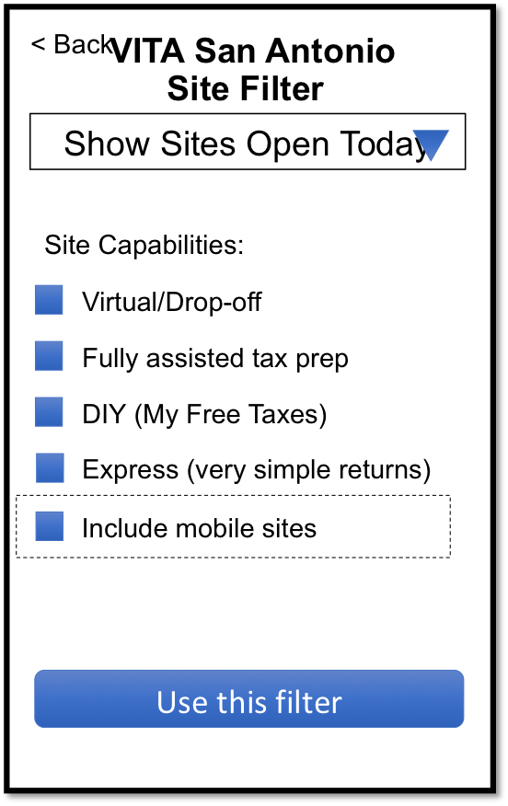
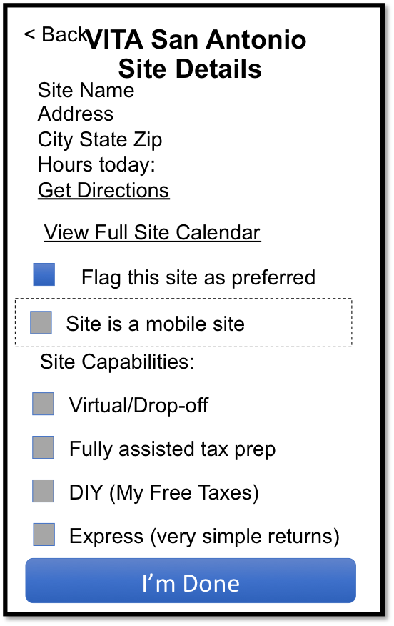
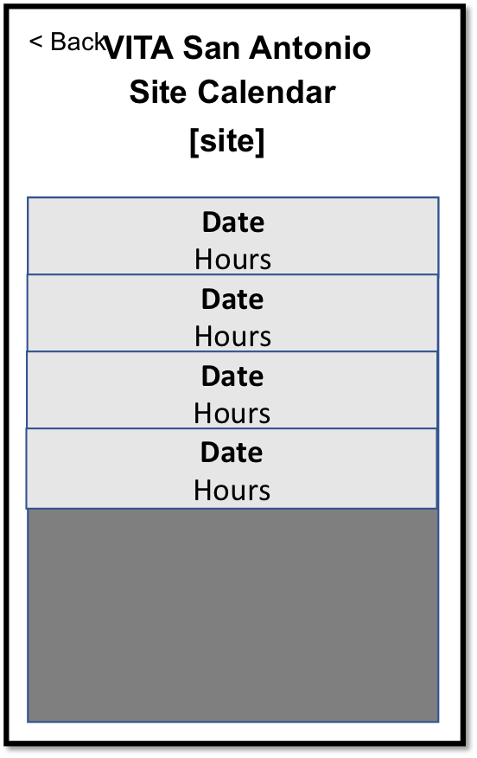
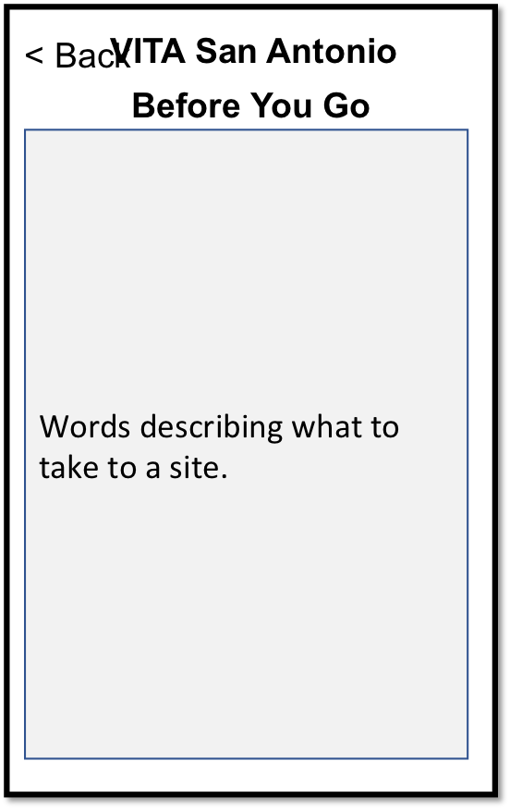
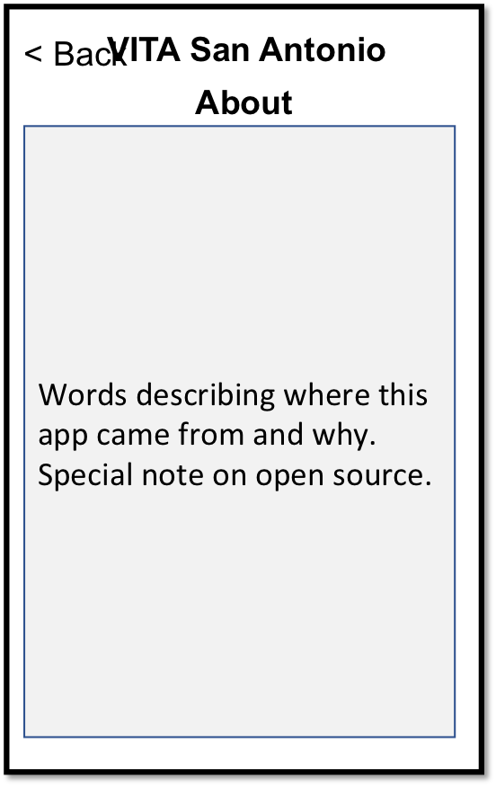
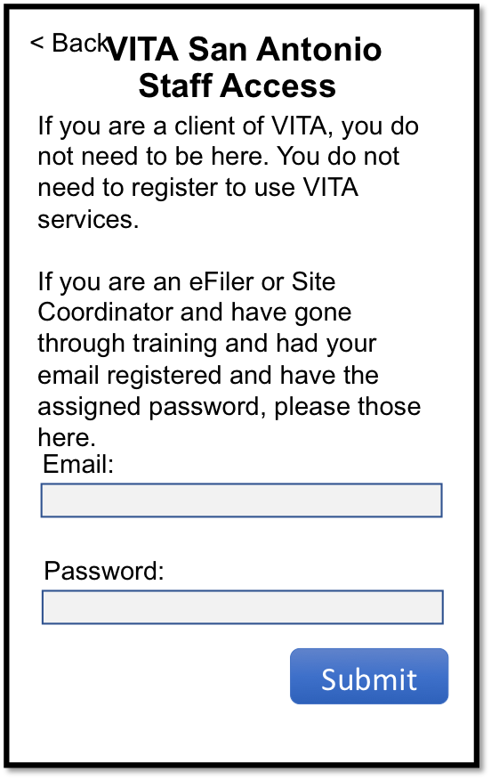
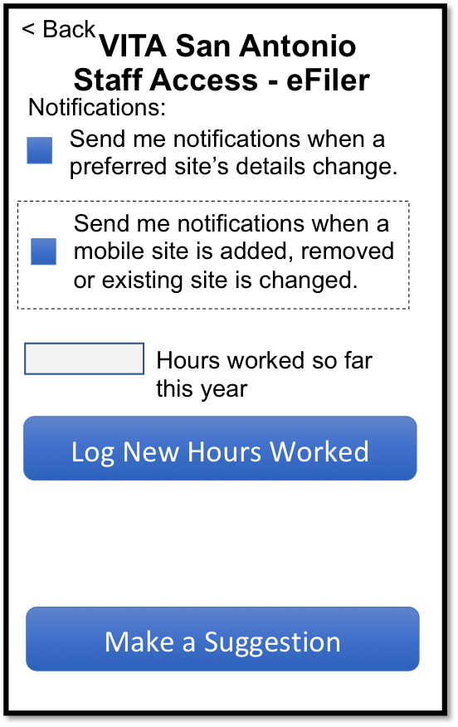
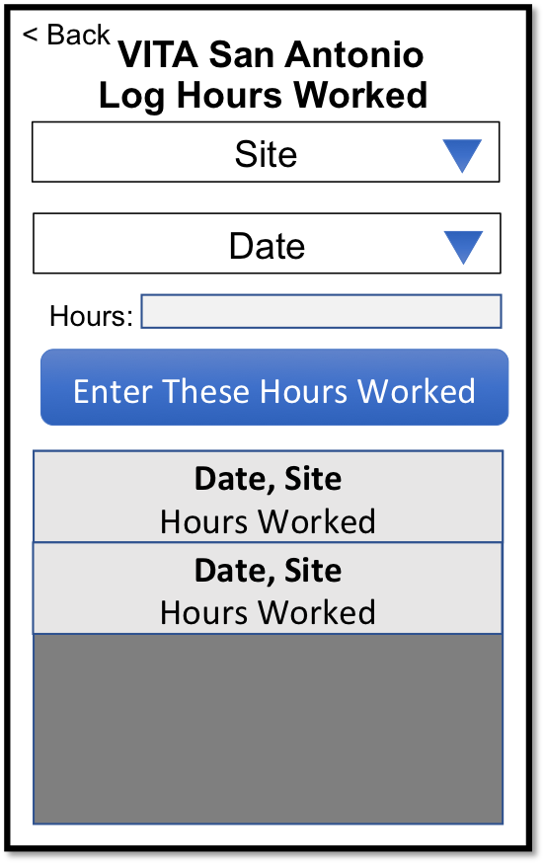
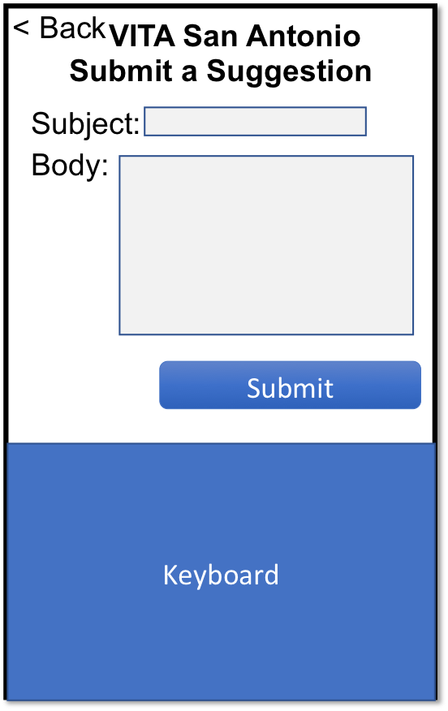
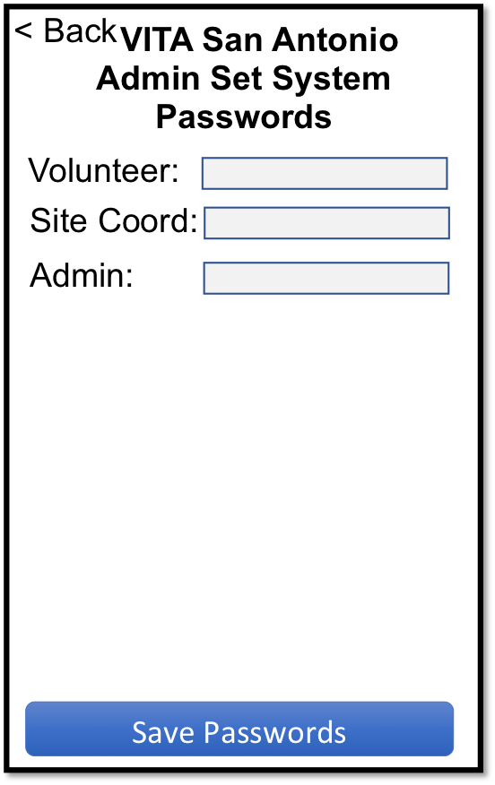
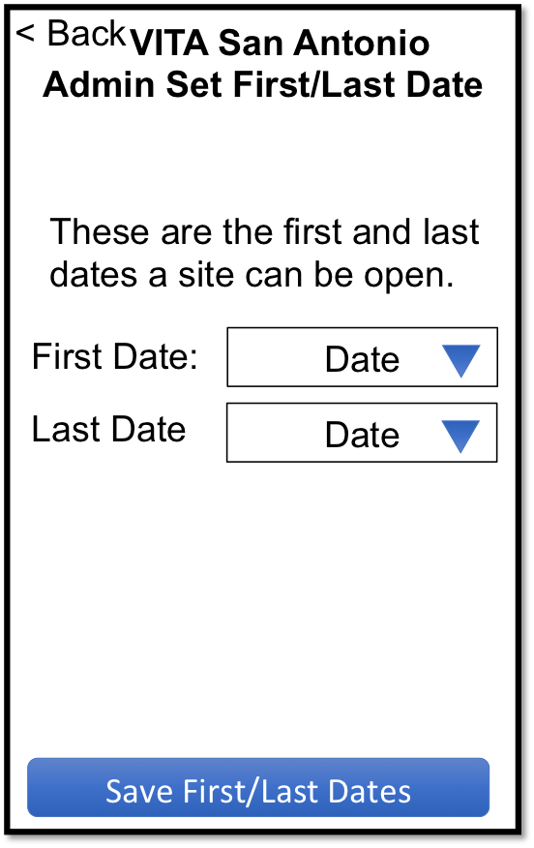
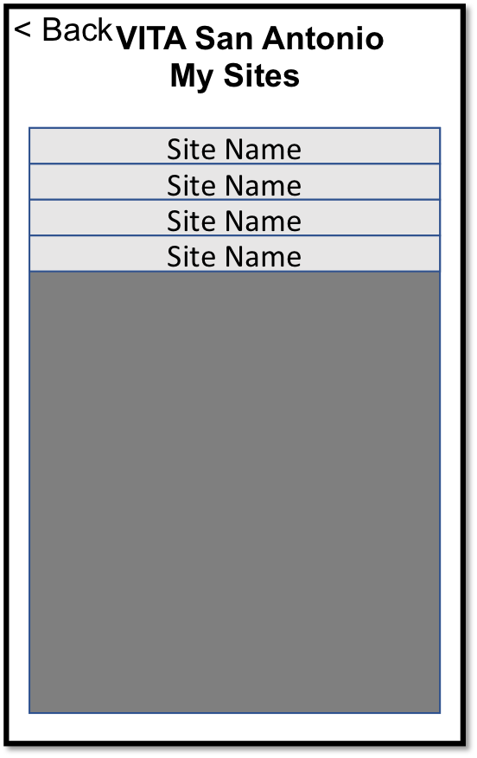
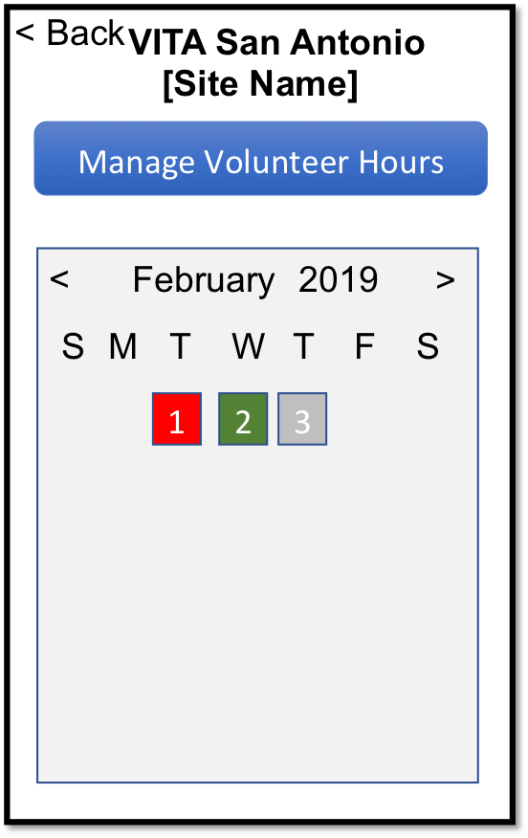
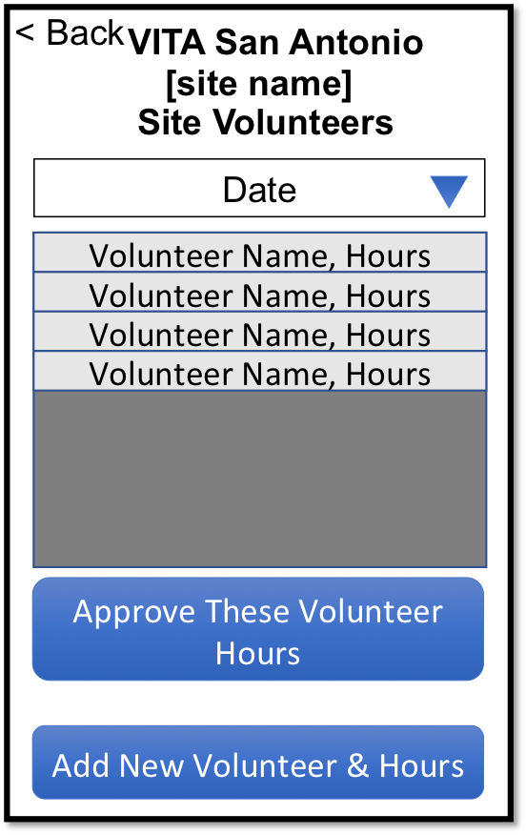
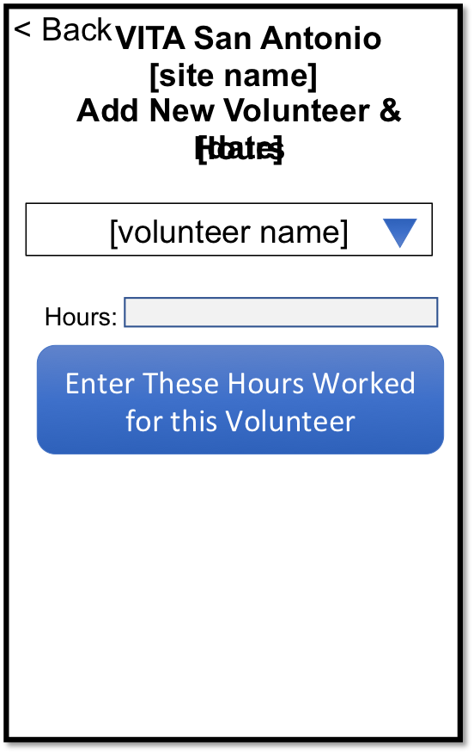
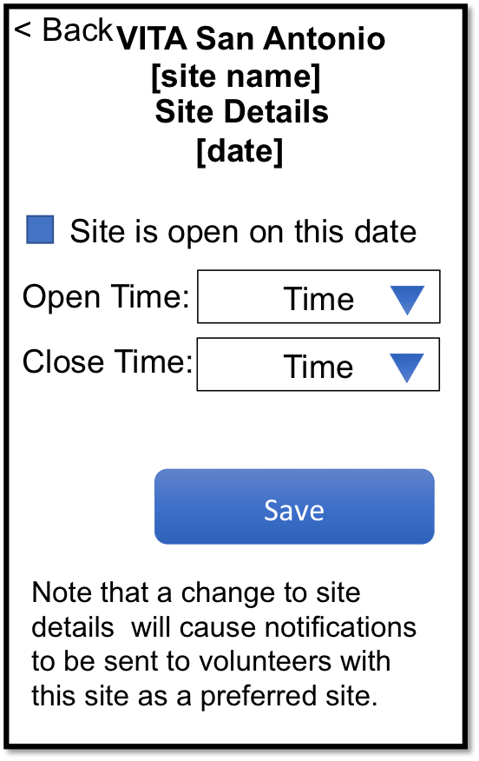
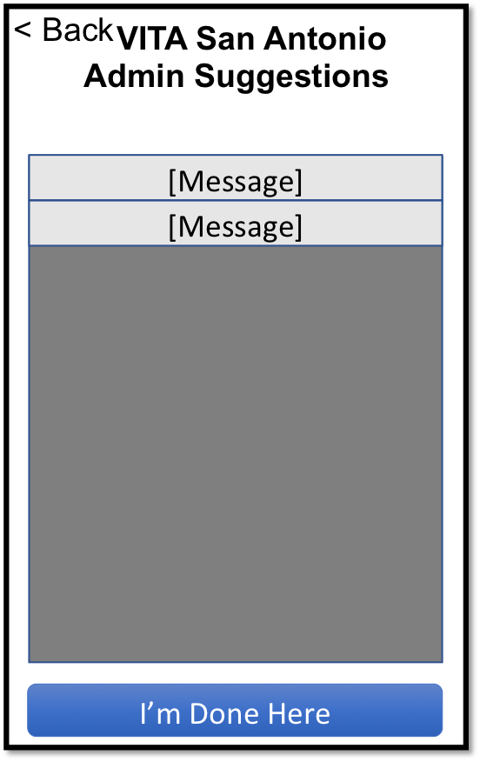
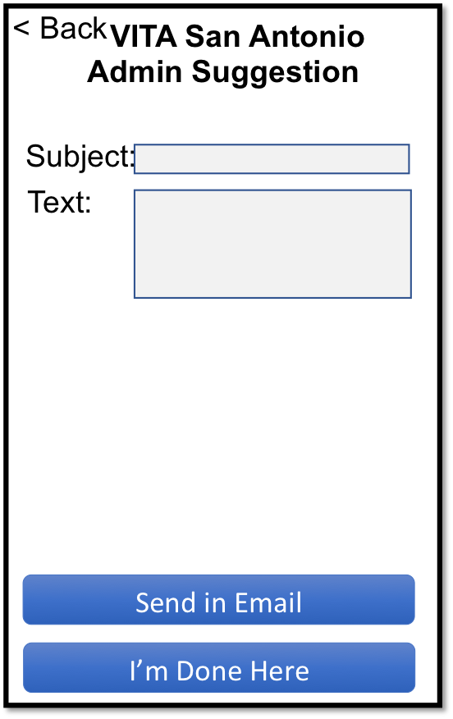
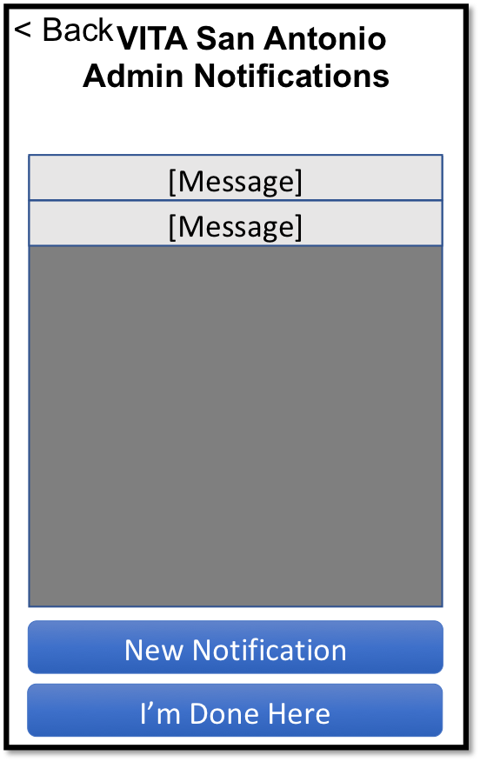
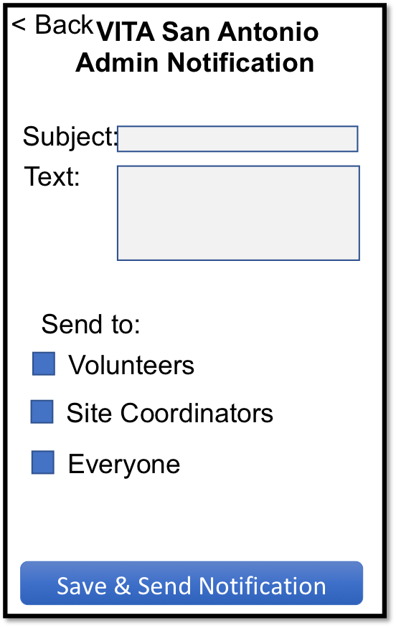
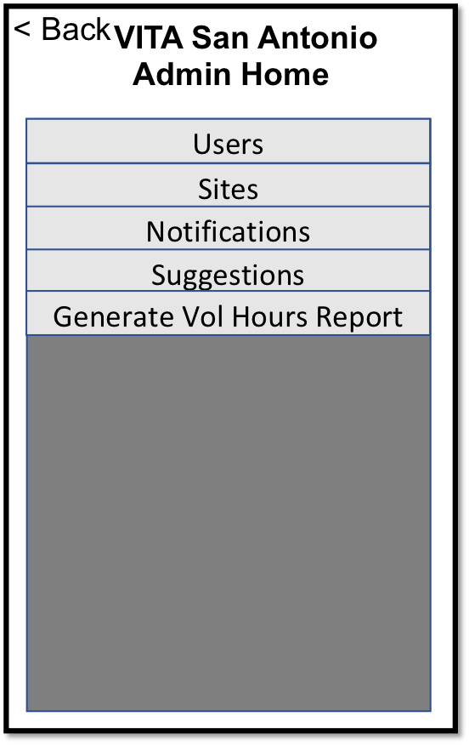
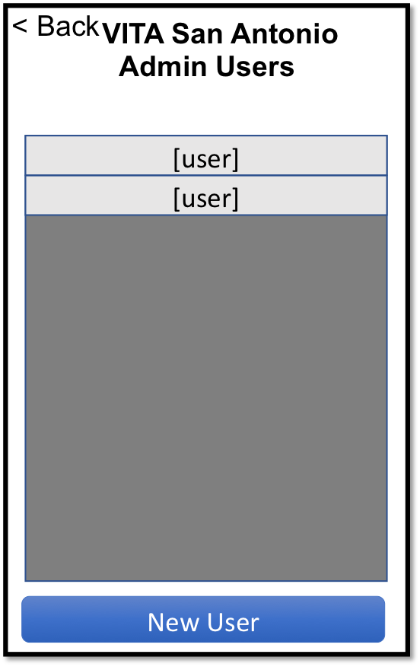
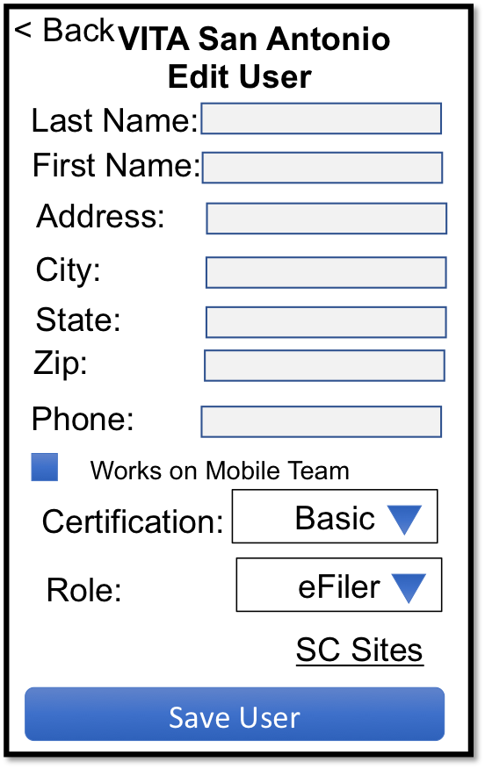
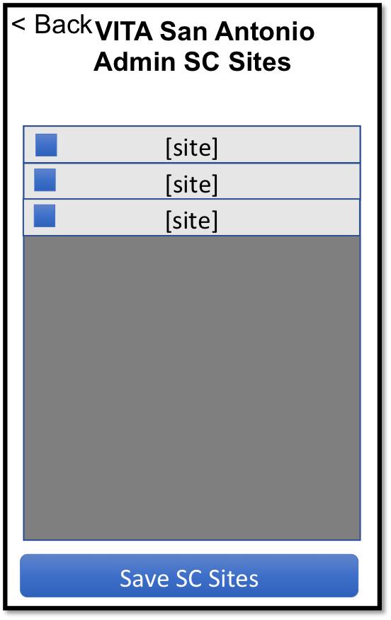

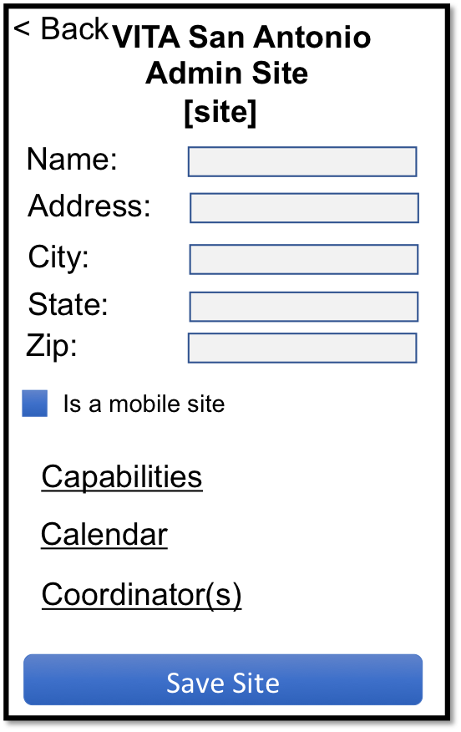
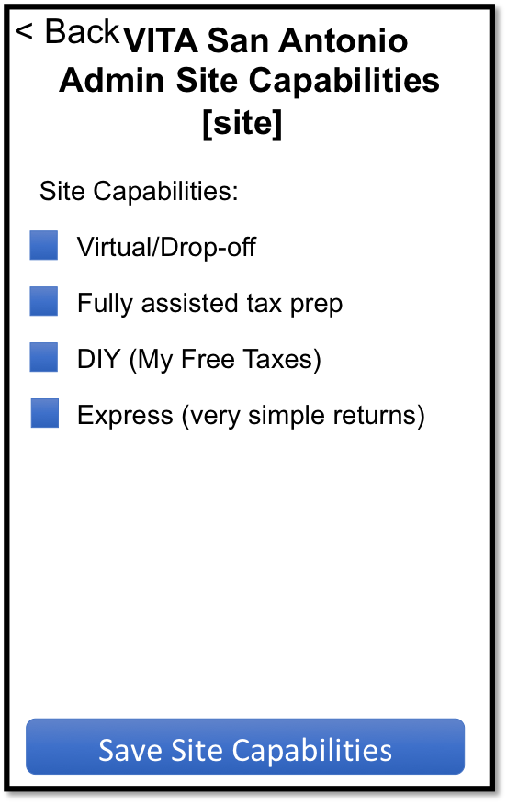
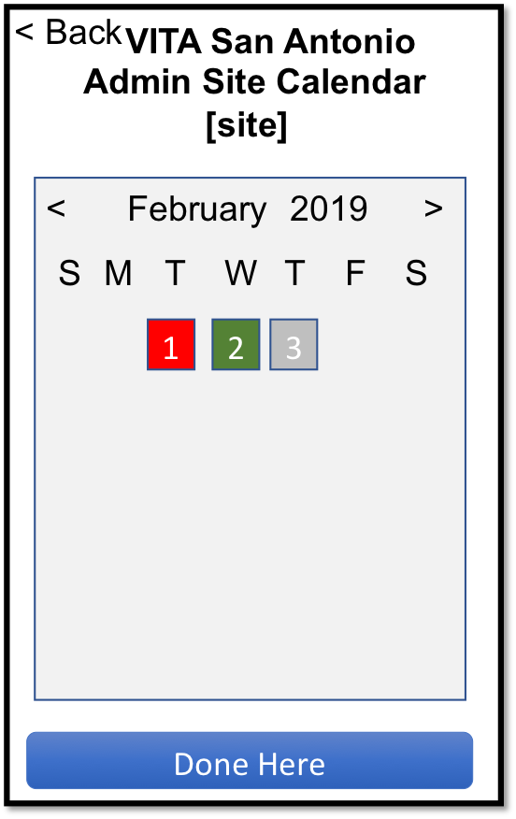
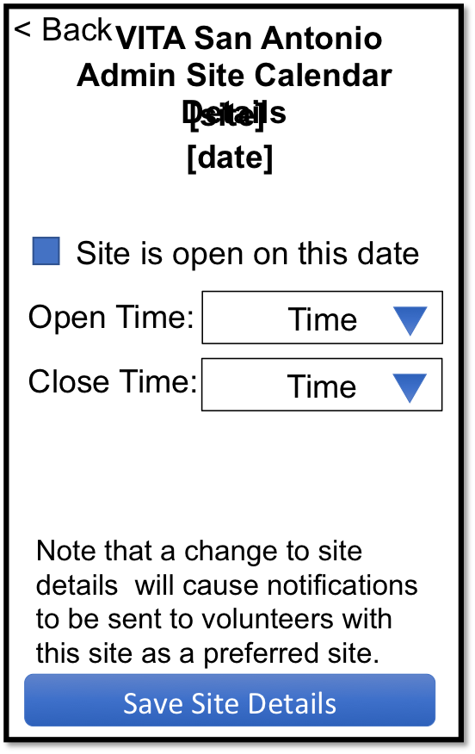
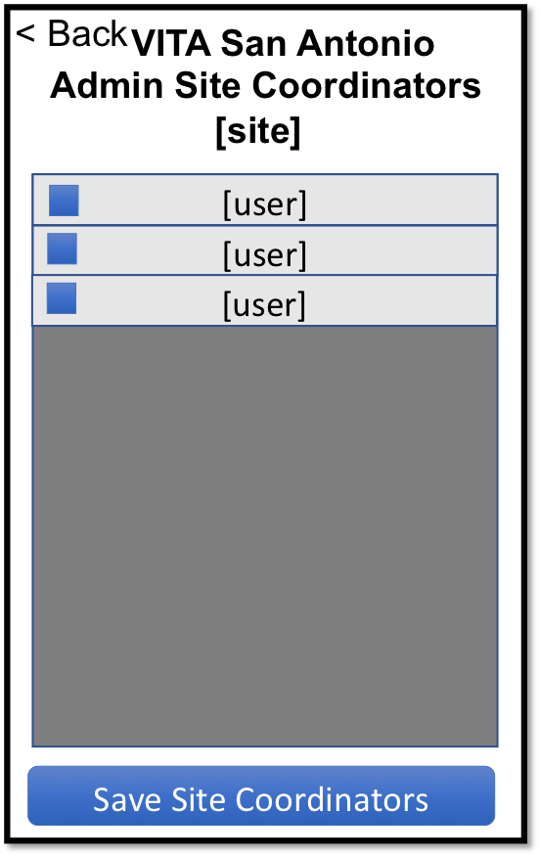

Slide 7
Main (all)
App opening screen – always
For clients, volunteers, SC’s, and admin
API
Get logged-in user details
VITA San Antonio
Find a Site Near You
Before You Go
Staff Access
About

Slide 8
Find a Site (all*)
For all users, show the map
Option to filter by date, by type
Highlight sites show a special flag
For volunteers that have registered and are signed in
Will show mobile sites if requested in the filter
Not logged in users will never see mobile sites
Touch site flag
See site details (address, etc.) or designate site as a preferred site (all users)
If preferred site is closed on the selected date, flag the nearest site that is open on that date
Only applies if a date is selected
API
Get logged-in user details
Get all sites details (with calendar)
VITA San Antonio
< Back
Map
Filter

Slide 9
Sites Filter (all*)
Drop down
All, Today, Tomorrow, next 5 calendar days
Mobile site option only shown if user is flagged for the mobile team
(web: merge into map display screen)
< Back
VITA San Antonio
Site Filter
Show Sites Open Today
Site Capabilities:
Virtual/Drop-off
Fully assisted tax prep
DIY (My Free Taxes)
Express (very simple returns)
Include mobile sites
Use this filter

Slide 10
Site Details (all*)
(web: merge onto map display screen)
API
If logged-in user: update list of preferred sites
< Back
VITA San Antonio
Site Details
Site Name
Address
City State Zip
Hours today:
Get Directions
View Full Site Calendar
Flag this site as preferred
Site is a mobile site
Site Capabilities:
Virtual/Drop-off
Fully assisted tax prep
DIY (My Free Taxes)
Express (very simple returns)
I’m Done

Slide 11
Site Calendar (all)
Used to view site hours for a given date
< Back
VITA San Antonio
Site Calendar
[site]
Date
Hours
Date
Hours
Date
Hours
Date
Hours

Slide 12
Before You Go (all)
(web: already on vitasa.org)
VITA San Antonio
< Back
Before You Go
Words describing what to take to a site.

Slide 13
About
(all)
VITA San Antonio
< Back
About
(web: already on vitasa.org)
Words describing where this app came from and why. Special note on open source.

Slide 14
Initial Login (Vol, SC, Admin)
For case when not currently logged in
Or when login failed (expired password)
Screen only shown once per year
(web: store email/password in a cookie)
API
User log in
Get user details
< Back
VITA San Antonio
Staff Access
If you are a client of VITA, you do not need to be here. You do not need to register to use VITA services.
If you are an eFiler or Site Coordinator and have gone through training and had your email registered and have the assigned password, please those here.
Email:
Password:
Submit

Slide 15
Vol Home (vol)
For the case when the user is an eFiler and has already provided the login credentials (and been accepted)
Mobile site option only shown if user is flagged for the mobile team
API
Get log of hours for user
Update user notification preferences
< Back
VITA San Antonio
Staff Access - eFiler
Notifications:
Send me notifications when a preferred site’s details change.
Send me notifications when a mobile site is added, removed or existing site is changed.
Hours worked so far this year
Log New Hours Worked
Make a Suggestion

Slide 16
Vol Hours Worked (vol)
Can view hours worked, add a new work item, or edit an existing (if not SC approved yet)
If touch table entry, will populate the above options with the value of that entry
Allow users to update
Can only update until approved by SC
Slide to delete hours workd
API
Create/edit/delete log for hours worked
< Back
VITA San Antonio
Log Hours Worked
Site
Date
Hours:
Enter These Hours Worked
Date, Site
Hours Worked
Date, Site
Hours Worked

Slide 17
Make Suggestion
(vol)
API
Create logged in user suggestion
< Back
VITA San Antonio
Submit a Suggestion
Subject:
Body:
Submit
Keyboard

Slide 18
SC Sites (SC)
Always arrive here if the user is a SC
My show only 1 site
Show a list of all Sites for this User as SC
< Back
VITA San Antonio
My Sites
Site Name
Site Name
Site Name
Site Name

Slide 19
SC Site (SC)
Always arrive here if the user is a SC
May show only 1 site
Show a list of all Sites for this User as SC
< Back
VITA San Antonio
[Site Name]
Manage Volunteer Hours
<
February
2019
>
S
M
T
W
T
F
S
1
2
3

Slide 20
Vol Hours (SC)
View entered hours for a site on a date
Defaults to today
List of volunteers and hours logged for the date, and approved status
Approve hours: flag all logged hours as approved
OK to approve again
If vol hours are missing, can enter them on another screen
Slide to delete a volunteer entry
< Back
VITA San Antonio
[site name]
Site Volunteers
Date
Volunteer Name, Hours
Volunteer Name, Hours
Volunteer Name, Hours
Volunteer Name, Hours
Approve These Volunteer Hours
Add New Volunteer & Hours

Slide 21
New Vol Hours (SC)
Select volunteer from list
Enter hours worked
Submit
< Back
VITA San Antonio
[site name]
Add New Volunteer & Hours
[date]
[volunteer name]
Hours:
Enter These Hours Worked for this Volunteer

Slide 22
Site Details
(SC)
Flag site open or closed
Adjust open/closed times
< Back
VITA San Antonio
[site name]
Site Details
[date]
Site is open on this date
Open Time:
Time
Close Time:
Time
Save
Note that a change to site details will cause notifications to be sent to volunteers with this site as a preferred site.

Slide 23
Admin Home
(Admin)
Used for general, common admin actions
Gen Vol Hours Report: alert for confirmation then UI goes dark until email generated (ie, no new screen)
(1) only shown if super admin
< Back
VITA San Antonio
Admin Home
Users
Sites
Notifications
Suggestions
Generate Vol Hours Report
Set System Passwords (1)
Set First/Last Date (1)

Slide 24
Admin Users
(Admin)
List of all users
Sorted by last name, first name
Slide to delete user (with confirm)
Touch user to edit
Add new User
< Back
VITA San Antonio
Admin Users
[user]
[user]
New User

Slide 25
Edit User
(Admin)
Edit user details
Roles: None, eFiler, SC, Admin
SC Sites link to set sites for an SC
Not available for any except SC
< Back
VITA San Antonio
Edit User
Last Name:
First Name:
Address:
City:
State:
Zip:
Phone:
Works on Mobile Team
Certification:
Basic
Role:
eFiler
SC Sites
Save User

Slide 26
Admin SC Sites
(Admin)
Adjust sites that an SC can manage
Slide to remove (with verification)
< Back
VITA San Antonio
Admin SC Sites
[site]
[site]
[site]
Save SC Sites

Slide 27
Admin Sites
(Admin)
< Back
VITA San Antonio
Admin Sites
[site]
[site]
New Site

Slide 28
Admin Site
(Admin)
On save, check that google can resolve
< Back
VITA San Antonio
Admin Site
[site]
Name:
Address:
City:
State:
Zip:
Is a mobile site
Capabilities
Calendar
Coordinator(s)
Save Site

Slide 29
Admin Site Capabilities
(Admin)
< Back
VITA San Antonio
Admin Site Capabilities
[site]
Site Capabilities:
Virtual/Drop-off
Fully assisted tax prep
DIY (My Free Taxes)
Express (very simple returns)
Save Site Capabilities

Slide 30
Admin Site Calendar
(Admin)
< Back
VITA San Antonio
Admin Site Calendar
[site]
<
February
2019
>
S
M
T
W
T
F
S
1
2
3
Done Here

Slide 31
Admin Site Calendar
(Admin)
< Back
VITA San Antonio
Admin Site Calendar Details
[site]
[date]
Site is open on this date
Open Time:
Time
Close Time:
Time
Note that a change to site details will cause notifications to be sent to volunteers with this site as a preferred site.
Save Site Details

Slide 32
Admin Site Coordinators
(Admin)
< Back
VITA San Antonio
Admin Site Coordinators
[site]
[user]
[user]
[user]
Save Site Coordinators

Slide 33
Notifications
(Admin)
List of previously send notifications
Touch to edit and/or send
Create new
< Back
VITA San Antonio
Admin Notifications
[Message]
[Message]
New Notification
I’m Done Here

Slide 34
Notification
(Admin)
Change as needed
Select targets
Back to cancel
S&S to make it happen
< Back
VITA San Antonio
Admin Notification
Subject:
Text:
Send to:
Volunteers
Site Coordinators
Everyone
Save & Send Notification

Slide 35
Suggestions
(Admin)
List of suggestions received
< Back
VITA San Antonio
Admin Suggestions
[Message]
[Message]
I’m Done Here

Slide 36
Suggestion
(Admin)
View only
< Back
VITA San Antonio
Admin Suggestion
Subject:
Text:
Send in Email
I’m Done Here

Slide 37
Set System PW’s
(Admin)
Only for super-admin
< Back
VITA San Antonio
Admin Set System Passwords
Volunteer:
Site Coord:
Admin:
Save Passwords

Slide 38
Set First/Last
(Admin)
Only for super-admin
< Back
VITA San Antonio
Admin Set First/Last Date
These are the first and last dates a site can be open.
First Date:
Date
Last Date
Date
Save First/Last Dates

